Slide 1
Lab 2: Exploring Data with Graphical Displays and Numerical Summaries
As you enter room:
* Find your name on the sign in sheet.
**Find the Table you were randomly assigned.
*** Sit at any of the seats and the table you were assigned.

Slide 2
Introduction to Labs
Lab Instructor:
Pre-Labs:
Assignments that must be done before the lab starts.
Found on MyStatLab under the Homework tab.
Lowest 2 are dropped.
Only open a day before the labs.
SAWA (Short Answer Writing Assignment):
Questions from the lab book.
Everyone must have their own lab book – penalty if missing lab book more than once.
Everyone must turn in their own SAWA (even if using group answers).
Graded by lab instructor and returned at the next lab.
Grades found on MyStatLab. (If grade on MyStatLab is not correct then email me and/or bring back your returned graded work).
EWA (Extended Writing Assignment):
Paper to be written on a particular lab.
You may do it for Lab 4 or Lab 8. Recommended for Lab 4. If you do poorly on the one for Lab 4 you may do Lab 8 as well and your higher grade will be kept.
More when we get closer to these labs.

Slide 3
Introduction to Labs
Lab Groups are Random:
You will find your table assignment on the sign in sheet.
Basic Flow of Labs:
Data Collection
Data Analysis
Answer Questions from Book (SAWA)
Work with your lab groups to answer the questions.
Make sure you answer the questions completely.
Ask the lab instructor for help if you have a question (you want a high lab grade).
Note this is not the same thing as asking the lab instructor for an answer.

Slide 4
Concepts Needed for Lab 2
Types of Variables:
Discrete Quantitative – results are numbers that represent a count (“the number of …”).
Continuous Quantitative – results are numbers that represent a measurement.
Categorical – numbers that are not counts or measurements and anything that is not a number.
Graphical Displays and Numerical Summaries:
To determine which graphical displays and numerical summaries are appropriate for a variable reference Table 2.1 on page 10.

Slide 5
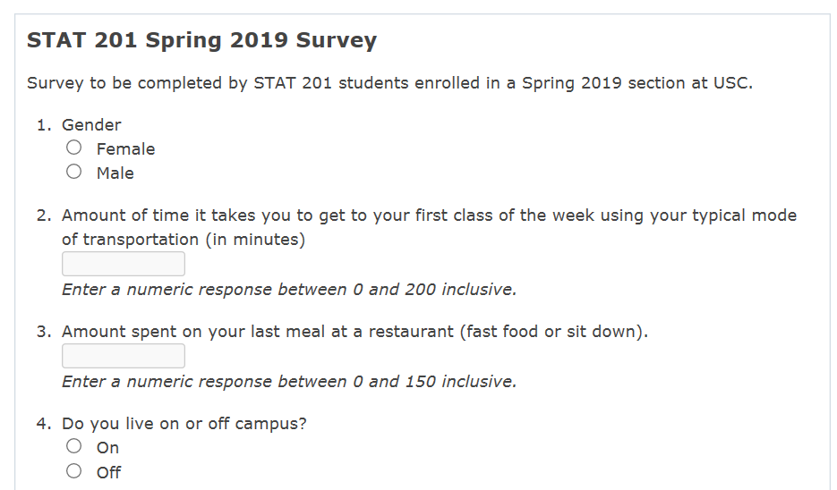
Data Collection for Lab 2
All students enrolled in STAT 201 were asked to complete participate in a survey (the one you were emailed the link to and the one that was found in the Pre-Lab Introduction assignment).

Slide 6
Accessing the Survey Data for Analysis
Logon to a computer:
Work in pairs on the computers in the room (must work with someone from your table).
You may use a laptop; however, you will have to print so at some point you are going to have to get on a computer in the room.
Log onto StatCrunch.com:
www.statcrunch.com
Sign in using your MyStatLab ID and password.
Navigate to the survey dataset created:
Click Explore
Select Data
Type in Name of Dataset in Browse all Search field on left side of screen (Or copy it):
Response to STAT 201 Fall 2019 Survey
Start Answering the questions on pages 13 and 14 of the lab book.

Slide 7
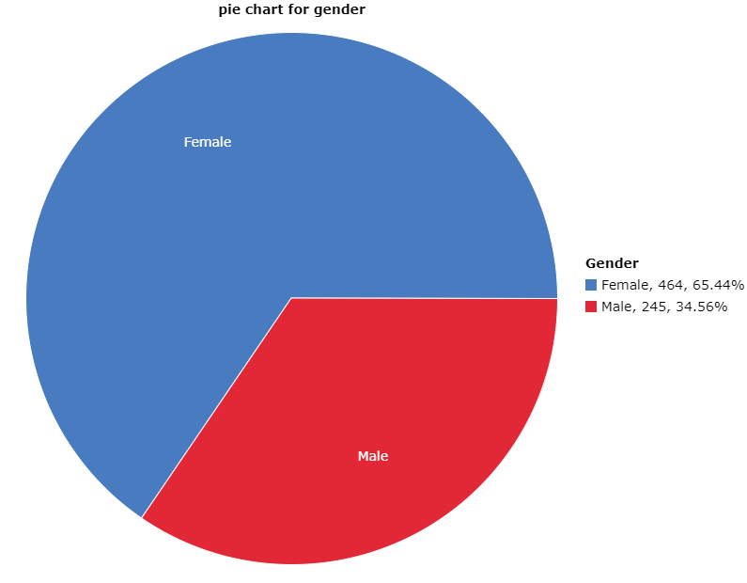
Categorical vs Quantitative Review
1. One categorical variables Example:
Graph: Graph->Pie Chart->With Data-> Choose Gender in Select columns -> Compute
2. Choose another categorical variable, make a graph and save it in a word document, write one sentence to describe your observation.
Students who take Fall 2018 STAT 201:

Slide 8
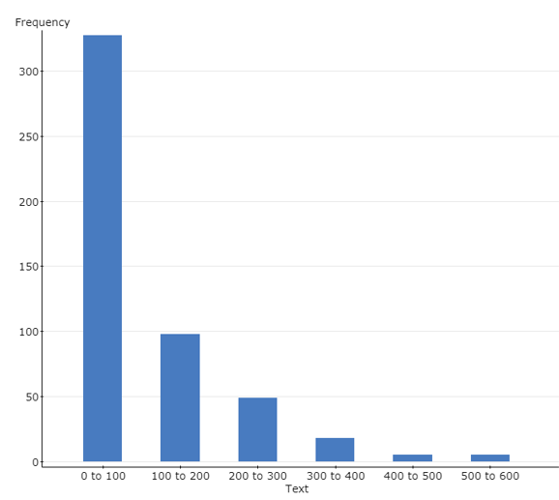

One quantitative variables:
Graph->Histogram->text->compute
Stat-> summary stats->columns->text->compute
Choose another quantitative variable, make a graph and save it in a word document, write one sentence to describe your observation.
How many text messages do you send per day?
For Students who take STAT 201:

Slide 9
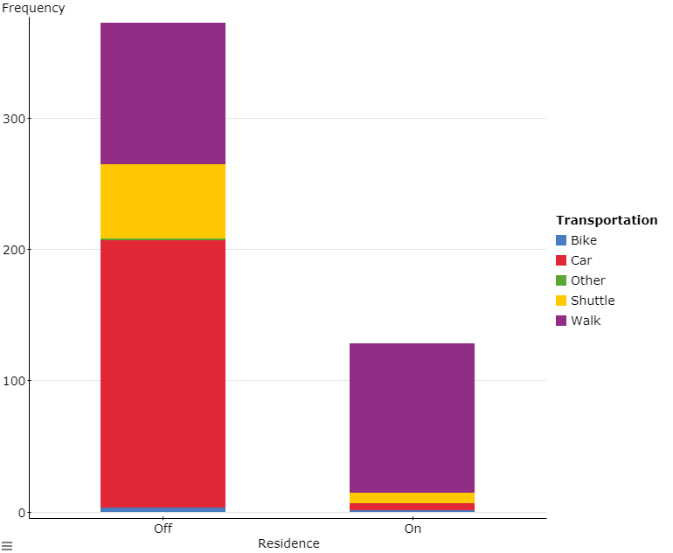
3.Two Categorical variables:
Students who take Fall 2018 STAT 201:
Graph->Bar plot->with data-> select column gender-> group by transportation-> stack bars->value above bar->compute
Choose other variables and make a graph, save it in a word document, write one sentence to describe your observation.

Slide 10
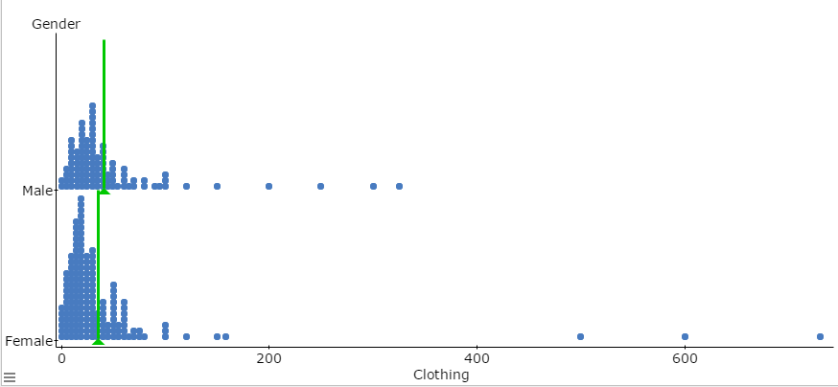
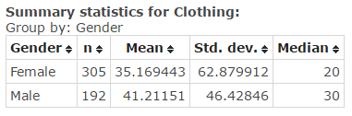
4.One quantitative and one Categorical variables:
How much does students spent on clothing
Graph->dotplot- select column clothing-> group by gender-> marker mean->compute
Stat-> summary stats->columns->clothing -> group by gender->compute
make a similar graph with other variables, save it in a word document, write one sentence to describe your observation.

Slide 11
Before you Leave
Turn in pages 13 and 14 from the lab book and the Word document you created with graphs, numerical summaries, and observations. Everyone needs to turn in their own work.
Make sure to fill in Table 2.2.
Reference table 2.1 on page 10 for what graphs and numerical summaries are appropriate.
For Numerical Summaries look under Summary Stats and Tables.
When working with Two Variables (#3 and #4) make sure your graphs have all information on one graph (use the Group by option).
Register for MyStatLab if you haven’t already. If you haven’t already done so make sure you do Pre-Lab Introduction and Pre-Lab 2 as they are due now (Before you leave lab today).

